Slide 1
CHAPTER 3
DATABASE MODELLING

Slide 2
Objectives of the chapter
At the end of the chapter : the student able to understand :-
Data Model and its categories
Types of Attribute
Relationships, Cardinality of a Relationship and Constraints
Entity Relationship Model
At the end of the chapter : the student able to understand :-
Data Model and its categories
Types of Attribute
Relationships, Cardinality of a Relationship and Constraints
Entity Relationship Model

Slide 3
Data Model
A specific DBMS has its own specific DDL to define a database schema, but this type of language is too low level to describe the data requirements of an organization in a way that is readily understandable by a variety of users.
It needs a higher-level description, Such a higher-level description of the database schema is called data-model.
It is a description of the way that data is stored in a database.
Describing
Data
Data relationship
Data semantics
Data constraints

Slide 4
Importance of Data Models
Representations of complex real-world data structures.
Facilitate interaction among the designer, the applications programmer, and the end user.
Data model organizes data for various users.
Provides necessary means to achieve data abstraction.

Slide 5
Categories of data models
1) Record-based
Hierarchical Data Model
Network Data Model
Relational Data Model
2) Object-based
The E-R Model
The Object-Oriented Model
3) Physical
Unifying model.
Frame memory.

Slide 6
Record-based Data Models
Consist of a number of fixed format records.
Each record type defines a fixed number of fields; each field is typically of a fixed length.
Types of record based data model
Hierarchical Model
Network Data Model
Relational Data Model

Slide 7
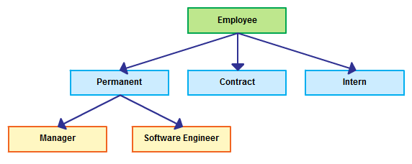
Hierarchical Model
The simplest data model.
And Record type is referred to as nodes or segments and the top node is the root node.
Nodes are arranged in a hierarchical inverted tree structure.
A parent node can have more than one child node .
A child node can only have one parent node.
The relationship between parent and child
is one-to-many

Slide 8
Cont’d
Advantages
Disadvantages
Hierarchical Model is simple to construct and operate on.
Corresponds to a number of natural hierarchically organized domains
e.g. Employee organization in companies.
Common database:-data sharing is easy and security is enforced by DBMS.
Creates environment for data independence.
Database is visualized as a linear arrangement of records
Complex to implement- Requires knowledge of physical level of storage.
Difficult to manage, not very flexible.
Multiple parent conditions occur in real world.

Slide 9

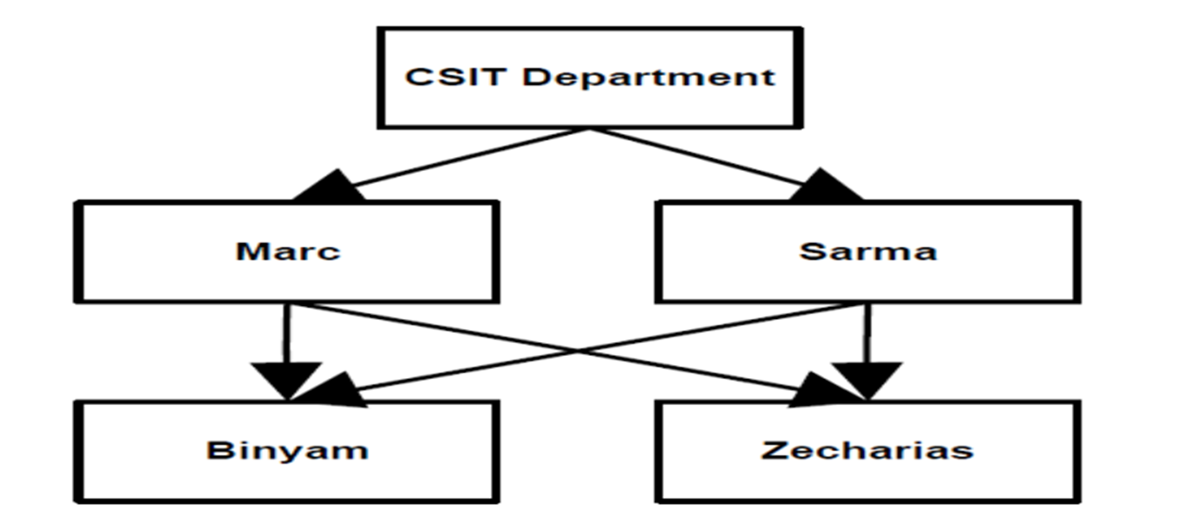
2. Network Model
Like hierarchical model, network model is a collection of physically linked records.
Resembles hierarchical model but allows record types to have more than one parent.
It can support M:N relationships

Slide 10
Cont’d
Advantages
Disadvantages
Network Model is able to represent complex relationships
Improved database performance.
More flexible and better data access method than hierarchical.
Achieves data independence by isolating programs from physical details.
Heavy pressure on programmers.
Complex structure from program point of view.
Difficult to design and use because in-depth understanding of structure is needed

Slide 11
3. Relational Data Model
Now the relational model is the dominant model for commercial data processing applications.
Terminologies originate from the branch of mathematics called Set Theory and Predicate Logic.
Can define more flexible and complex relationship
A relational database consists of a collection of tables, each having a unique name.
Order of rows and columns is immaterial
Entries with repeating groups are said to be un-normalized.
A row in a table represents a relationship among a set of values

Slide 12
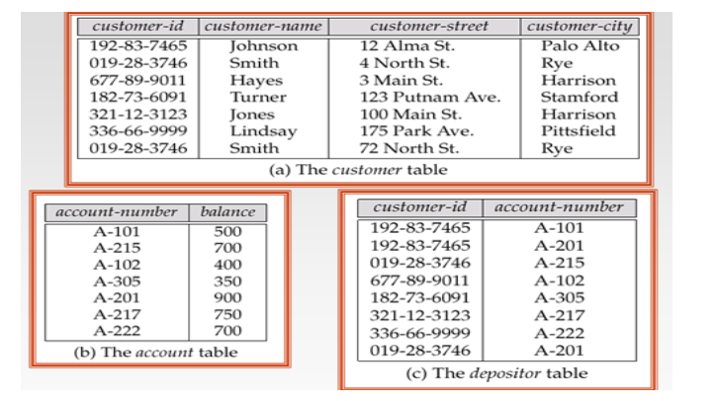
Cont’d
A sample relational database is given below.
There is a direct correspondence between the concept of a table and the mathematical concept of a relation

Slide 13
Relation:
Stores information or data in the form of two-dimensional tables - rows and columns
A row of the table is called tuple - equivalent to record
A column of a table is called attribute - equivalent to fields
Data value is the value of the Attribute.
Records are related by the data stored jointly in the fields of records in two tables or files which creates a relation.
Conceptually simple – Linked Tables as shown below

Slide 14
Cont’d

Slide 15
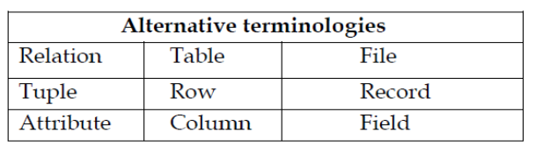
Important terms in Relational Data Model
Relation: a table with rows and columns
Attribute: a named column of a relation
Tuple: a row of a relation
Domain: a set of allowable values for one or more attributes
Degree: the degree of a relation is the number of attributes it contains.
Cardinality: of a relation is the number of tuples the relation has.

Slide 16
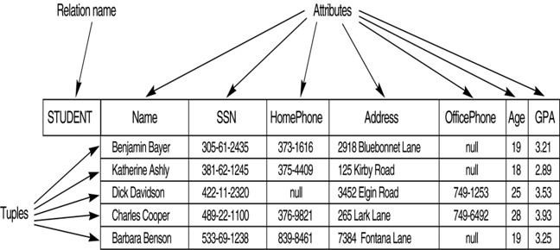
Cont’d

Slide 17
Cont..
Relation Schema: a named relation defined by a set of attribute-domain name pair
Let A1, A2...........An be attributes with domain D1, D2 ………,Dn.
Then the sets {A1:D1, A2:D2… An:Dn} is a Relation Schema.
A relation R, defined by a relation schema S, is a set of mappings from attribute names to their corresponding domains. Thus a relation is a set of n- tuples of the form (A1:d1, A2:d2 ,…, An:dn) where d1 є D1, d2 є D2,…….. dn є Dn,
Eg. Student (studentId char(10), studentName char(50), DOB date) is a relation schema for the student entity in SQL
Relational Database schema: a set of relation schema each with distinct names.
Suppose R1, R2,……, Rn is the set of relation schema in a relational database then the relational database schema (R) can be stated as: R={ R1 , R2 ,……., Rn}

Slide 18
Properties of Relational Databases
A relation has a name that is distinct from all other relation names in the relational schema.
Each tuple in a relation must be unique
All tables are Logical entities
Each cell of a relation contains exactly one atomic (single) value.
Each column (field or attribute) has a distinct name.
A table is either a Base tables (Named Relations) or Views (Unnamed Relations)
Only Base Tables are physically stored
Views are derived from Base tables with SQL statements

Slide 19
Building Blocks of the Relational Data Model
The building blocks of the relational data model are:
Entities: real world physical or logical object.
Attributes: properties used to describe each entity or real world object.
Simple Vs Composite attribues
Single-valued Vs. multi-valued attributes
Stored vs. Derived Attribute
Relationship: the association between entities
Constraints: rules that should be obeyed while manipulating the data.

Slide 20
Types of Attributes
(1) Simple (Atomic) Vs Composite Attributes
Simple : Contains a single value (not divided into sub parts).
E.g. Age, gender, marriage status
Composite: The attributes that can be divided into smaller subparts, which represent more basic attributes with independent meaning.
E.g. Name and address
(2) Single-valued Vs multi-valued Attributes
Single-valued: have only single value (the value may change but has only one value at one time).
E.g. Name, Sex, Id. No.
Multi-Valued: Having a set of values for the same entity.
May have lower and upper bounds on the number of values allowed for each individual entity.
E.g. Address, College Degree

Slide 21
Cont’d
3. Stored vs. Derived Attribute
Stored : not possible to derive or compute. E.g. Name, Address
Derived: The value may be derived (computed) from the values of other attributes.
E.g. Age (current year –year of birth), Length of employment (current date- started date) , Profit (earning-cost), G.P.A (grade point/credit hours
Null Values:-NULL applies to attributes which are not applicable or which do not have values.
Value of a key attribute can not be null.
Default value - assumed value if no explicit value

Slide 22
Cont’d
Degree of a Relationship: is the number of entities participating in a relationship.
An important point about a relationship is how many entities participate in it.
Among the Degrees of relationship, the following are the basic:
Unary/recursive relationship: Tuples/records of a Single entity are related with each other.
Binary relationships: Tuples/records of two entities are associated in a relationship e.g. ‘Customer’ and ‘Account’
Ternary relationship: Tuples/records of three different entities are associated and a generalized one: e.g. employee works in a department
N-ary relationship: Tuples from arbitrary number of entity sets is participating in a relationship.

Slide 23
Cardinality of a Relationship
Maximum number of relationship instances that an entity instances can participate in is cardinality of a relationship.
The major cardinalities of a relationship are:
One-to-One: one tuple is associated with only one other tuple.
E.g. Building:-Location as a single building will be located in a single location and as a single location will only accommodate a single Building.
One-to-Many: one tuple can be associated with many other tuples, but not the reverse.
E.g. Department-Student as one department can have multiple students.

Slide 24
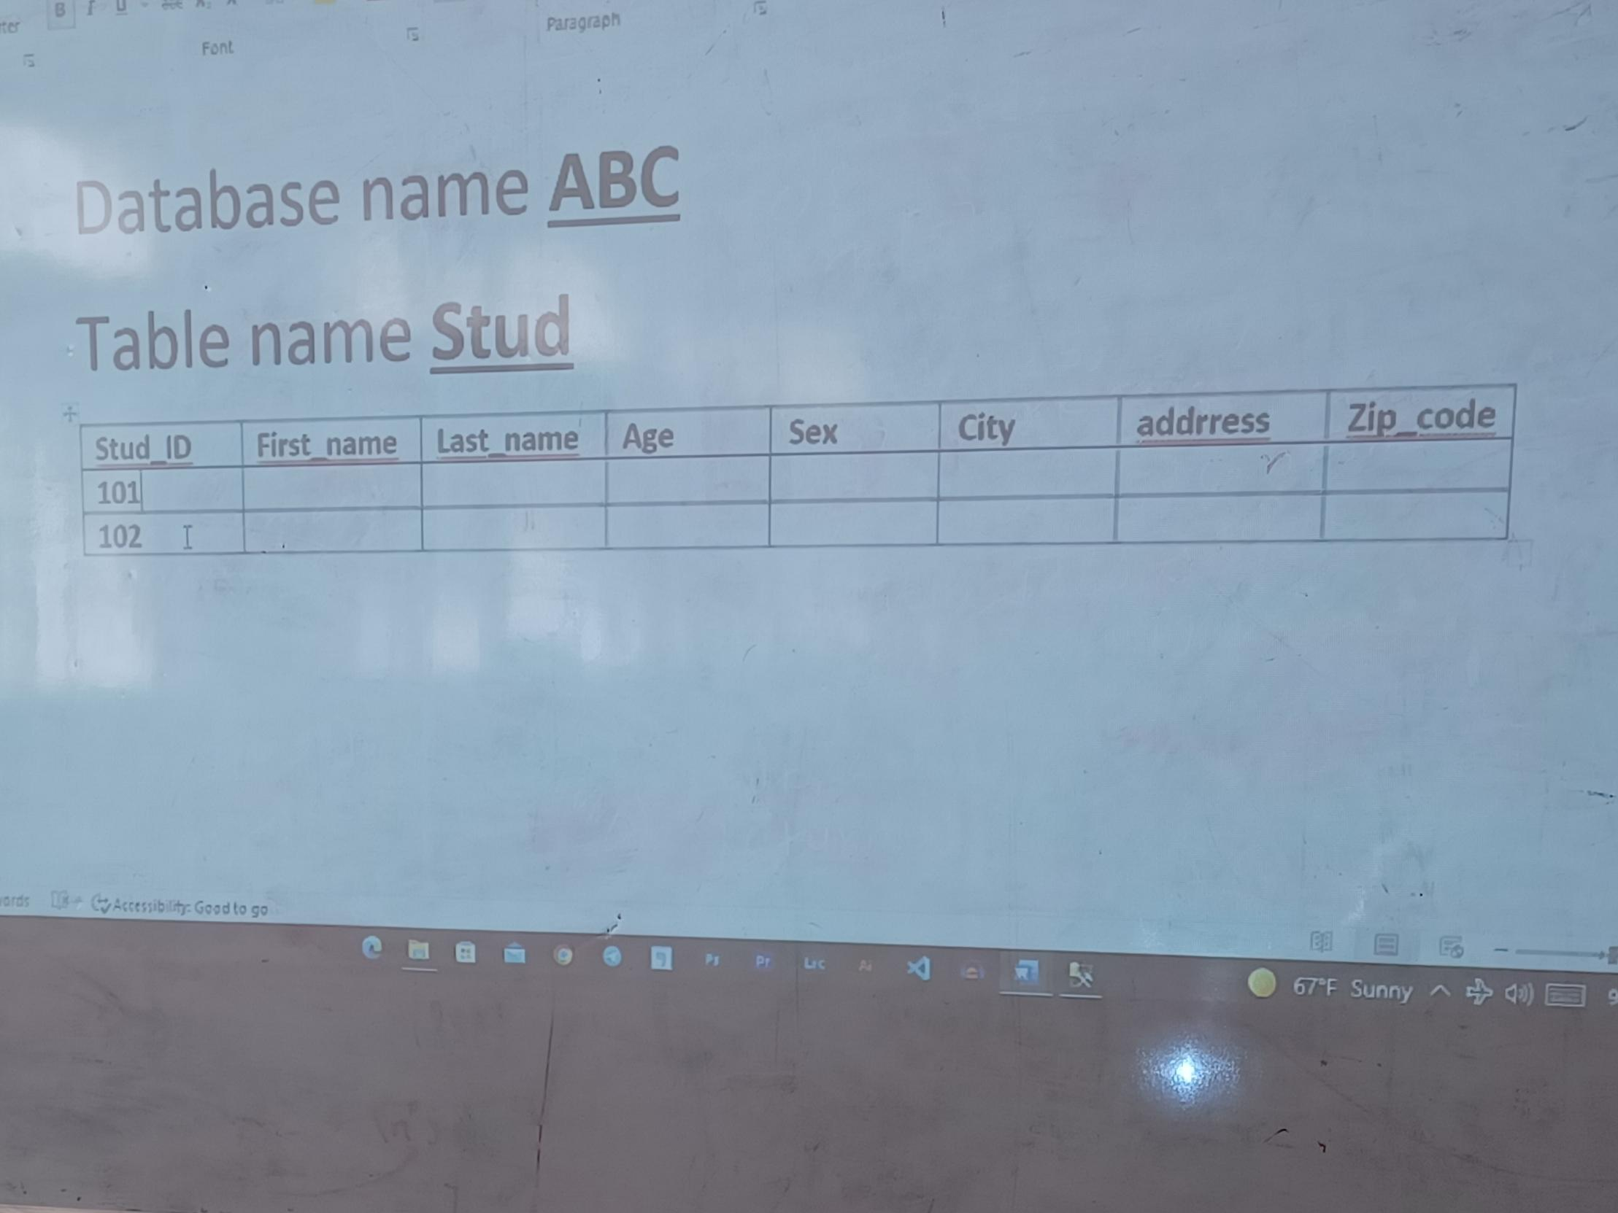

Slide 25
Cont’d
Many-to-One: many tuples are associated with one tuple but not the reverse.
E.g. Employee – Department: as many employees belong to a single department.
Many-to-Many: one tuple is associated with many other tuples and from the other side, with a different role name one tuple will be associated with many tuples
E.g. Student – Course as a student can take many courses and a single course can be attended by many students.

Slide 26
Constraints
If tuples are needed to be unique in the database, we need to make each tuple distinct.
To do this we need to have relational keys that uniquely identify each record.
Super Key: an attribute/set of attributes that uniquely identify a tuple within a relation.
Candidate Key: a super key such that no proper subset of that collection is a Super Key within the relation.
If a super key is having only one attribute, it is automatically a Candidate key.
If a candidate key consists of more than one attribute it is called Composite Key.

Slide 27
Cont’d
Primary Key: the candidate key that is selected to identify tuples uniquely within the relation.
Primary key Value is unique for each record in a table and value cannot be used twice.
Foreign Key: an attribute, or set of attributes, within one relation that matches the candidate key of some relation.
Foreign key is used to create relationships between tables.
Foreign key is a column whose values are derived from the primary key or unique key of some other tables.

Slide 28
Relational Constraints/Integrity Rules
An integrity constraint (IC) is a condition that is specified on a database schema and restricts the data can be stored in an instance of the database.
Various restrictions on data that can be specified on a relational database schema in the form of ‘constraints’.
A DBMS enforces integrity constraints, in that it permits only legal instances to be stored in the database.
Integrity constraints are specified and enforced at different times as below.
When the DBA or end user defines a database schema, he or she specifies the ICs that must hold on any instance of this database.
When a database application is run, the DBMS checks for violations and disallows changes to the data that violate the specified ICs.

Slide 29
Cont’d
The Relational constraints can be classified into 4 types as below.
Domain Integrity: No value of the attribute should be beyond the allowable limits
Entity Integrity: In a base relation, no attribute of a Primary Key can assume a value of NULL
Referential Integrity: If a Foreign Key exists in a relation, either the Foreign Key value must match a Candidate Key value in its home relation or the Foreign Key value must be NULL
Enterprise Integrity: Additional rules specified by the users or database administrators of a database are incorporated.

Slide 30
Object-based Logical Models
Describe data at the conceptual and view levels.
Provide fairly flexible structuring capabilities.
Allow one to specify data constraints explicitly.
Such models, including
Entity-relationship model.
Object-oriented model.
Binary model.
Semantic data model.
At this point, we'll take a closer look at the entity-relationship (E-R) and object-oriented models.

Slide 31
Entity Relationship Model (ERM)
Introduced by Peter Chen in 1976
Widely accepted and adapted graphical tool for data modeling
The entity-relationship model is based on a perception of the world as consisting of a collection of basic objects (entities) and relationships among these objects.
Graphical representation of entities and their relationships in a database structure.

Slide 32
Entity Relationship Model (ERM)
An entity is a distinguishable object that exists.
Each entity has associated with it a set of attributes describing it.
E.g. number and balance for an account entity.
A relationship is an association among several entities.
E.g. A cust_acct relationship associates a customer with each account he/she has.
The set of all entities or relationships of the same type is called the entity set or relationship set.
Another essential element of the E-R diagram is the mapping cardinalities.

Slide 33
E-R model of real world
Entities (objects)
E.g. customers, accounts, bank branch
Relationships between entities
E.g. Account A-101 is held by customer Johnson
Relationship set deposits associates customers with accounts
Widely used for database design
Produces specification of the data and relationship to maintain in the database.
Database design in E-R model usually converted to design in the relational model, which is used for storage and processing

Slide 34


Slide 35


Slide 37
Cont’d
The overall logical structure of a database can be expressed graphically by an E-R diagram:
Rectangles: represent entity sets.
Ellipses: represent attributes.
Diamonds: represent relationships among entity sets.
Lines: link attributes to entity sets and entity sets to relationships.

Slide 38
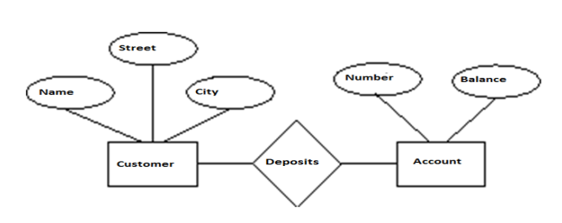
Cont..

Slide 39
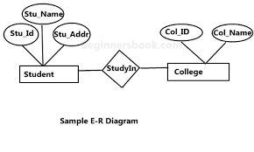
Cont..

Slide 40

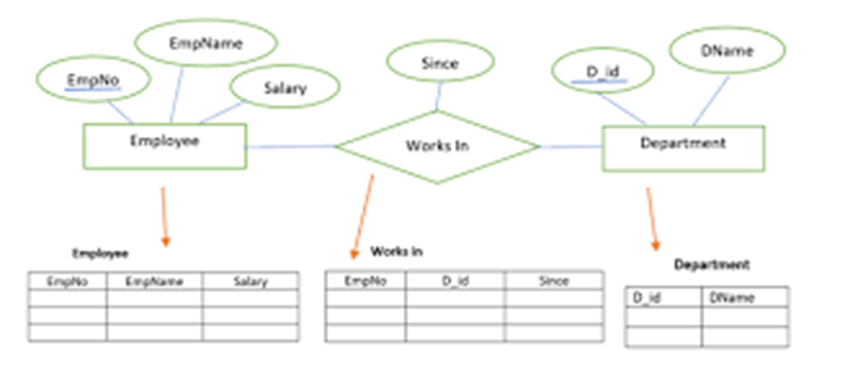
Cont..

Slide 41
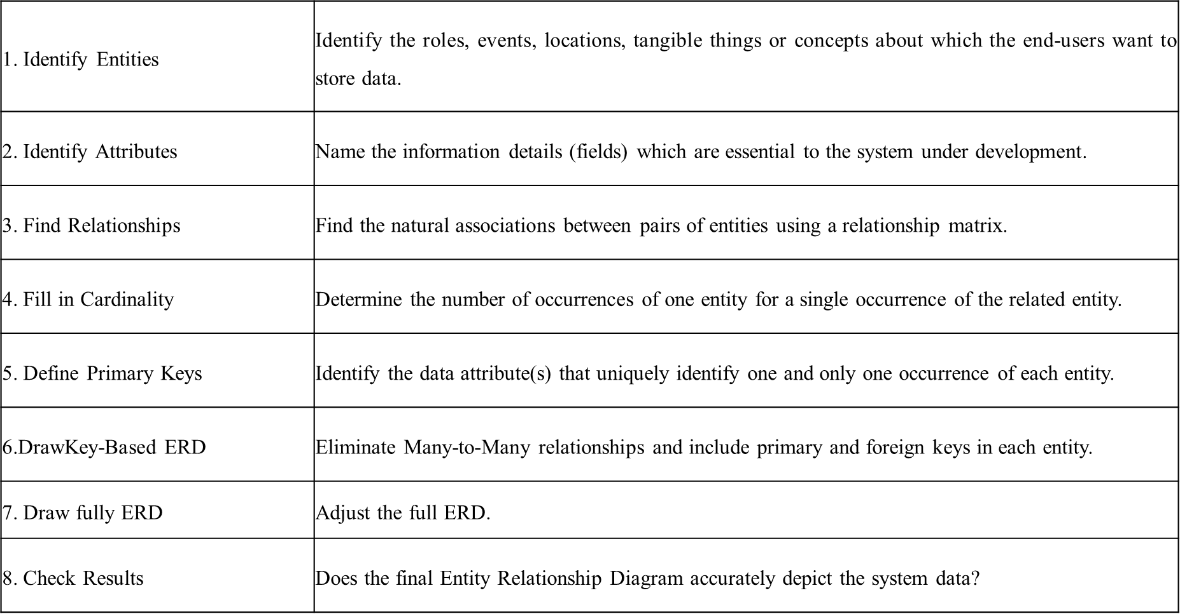
An Entity Relationship Diagram Methodology

Slide 42
The Object-Oriented Model
Like the E-R model, the object-oriented model is based on a collection of objects.
An object contains values stored in instance variables within the object.
Unlike the record-oriented models, these values are themselves objects.
An object also contains bodies of code (methods) that operate on the object.
Objects that contain the same types of values and the same methods are grouped into classes.
A class may be viewed as a type definition for objects.
Two objects containing the same values are distinct.
Object-oriented data model (OODM)

Slide 43
Cont..
Basis of object-oriented database management system (OODBMS)
Object – abstraction of a real-world entity
Attributes – properties of an object
Class - objects that share similar characteristics & behavior.
Classes are organized in a class hierarchy
Inheritance – an object within the class hierarchy inherits the attributes and methods of a class
Physical Data Models
Are used to describe data at the lowest level.
Very few models,
Unifying model.

Slide 44
Assignment
Select any organization
Identify the entities and their attributes
Identify the degree of their relationship
Identify their cardinalities
Constraints
Draw the ERD

Slide 45
Thank you!!

